Slide 1
Residential water saving in Greece: our way forward
Eficiência Hídrica em Edifícios e Espaços Públicos
30 de maio de 2012
Ismini Maria Kyriazopoulou
Project Coordinator
Development of a Household
Watersaving Policy

Slide 2
Presentation Topics
Introduction
Proposed Building Level Measures
Proposed Product Level Measures
Proposed Financial Incentives
Conclusions

Slide 3
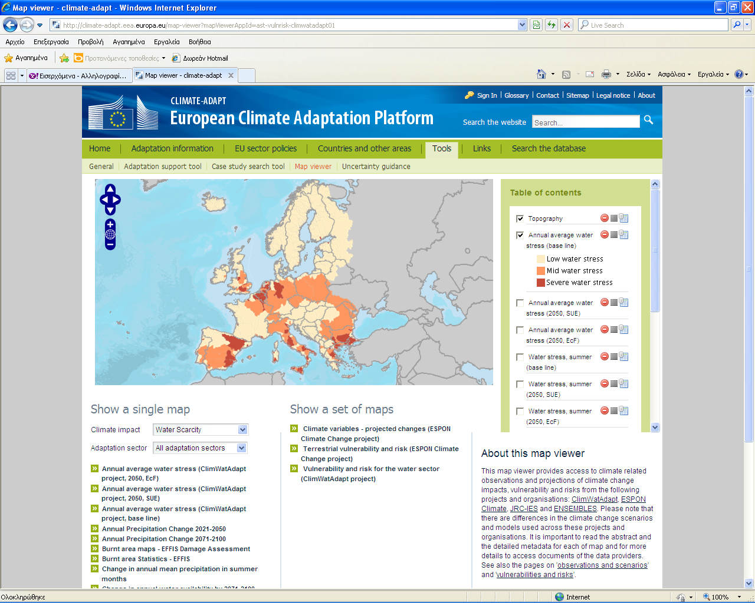
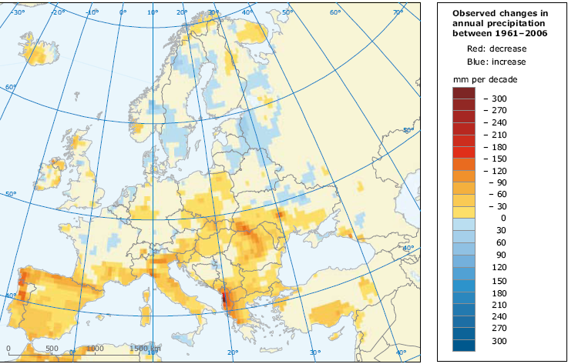
Introduction (1)
Climate change effects are now evident
Expected water stress calls for adaptation measures in what regards population, economic activities an infrastructure

Slide 4
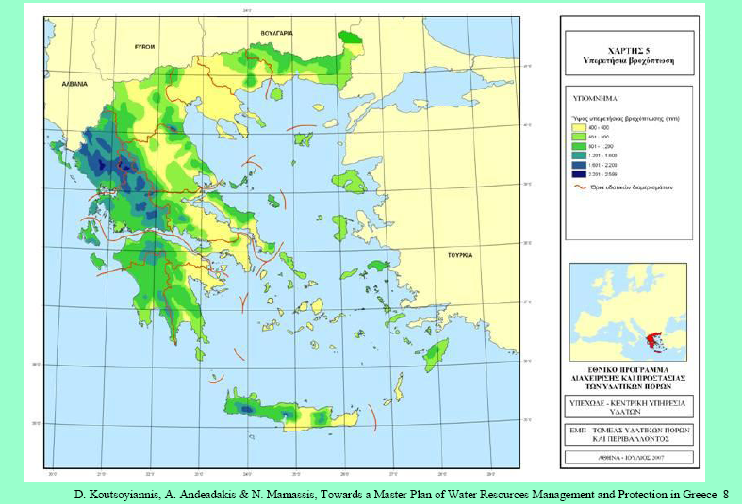
Introduction (2)
Geographical Distribution of Rainfall

Slide 5
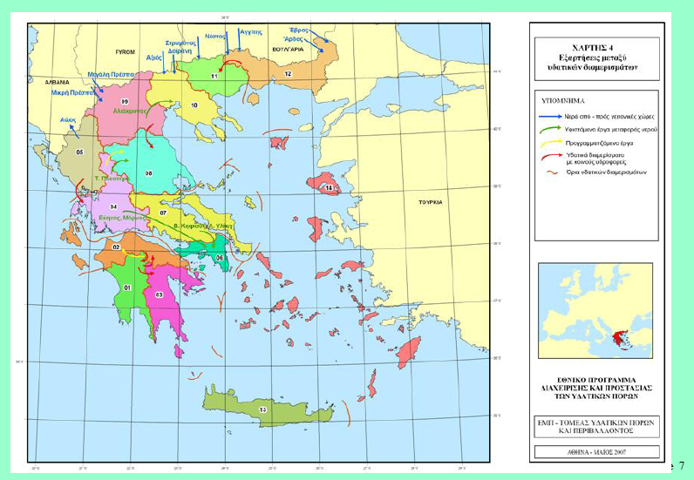
Introduction (3)
Greek WBDs

Slide 6
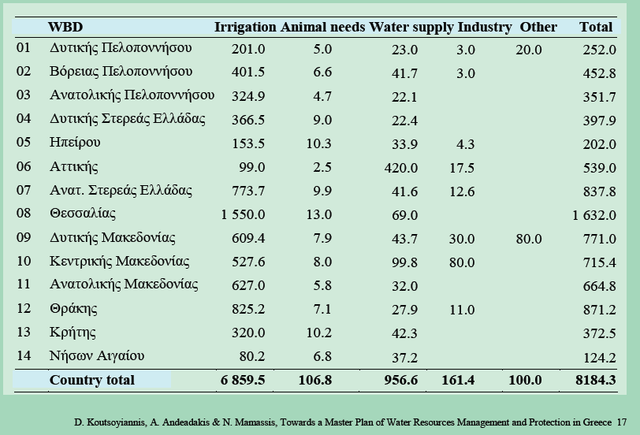
Introduction (4)
W. Peloponnese
N. Peloponnese
E. Peloponnese
W. Sterea Ellada
Epirus
Attica
E. Sterea Ellada
Thessaly
W. Macedonia
C. Macedonia
E. Macedonia
Thrace
Crete
Aegean islands
Greek Water Consumption per Sector

Slide 7
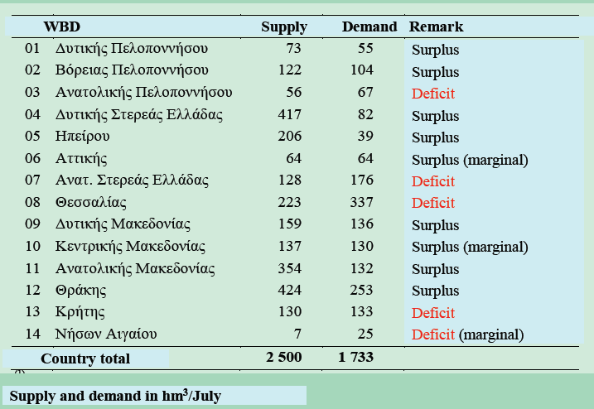
Introduction (5)
W. Peloponnese
N. Peloponnese
E. Peloponnese
W. Sterea Ellada
Epirus
Attica
E. Sterea Ellada
Thessaly
W. Macedonia
C. Macedonia
E. Macedonia
Thrace
Crete
Aegean islands
Greek Water Balance per WBD

Slide 8
Introduction (6)
The Greek Ministry of Environment started examining the idea of a Residential Watersaving Plan in April 2011
The expert study was concluded in January 2012
It was concluded that simple interventions could accomplish 30% savings per household and 10% savings in the domestic water supply overall
A combination of Building Level and Product Level measures was examined

Slide 9
Introduction (7)
The Proposed Action Plan included the following:
Mandatory water performance for new buildings
Mandatory rainwater harvesting for specific priority areas
Establishing a Watersaving Label for WuPs
Financial incentives for water saving equipment in old buildings
Financing Pilot Projects

Slide 10
Building Level Measures (1)
Examined alternatives:
Voluntary water performance rating of
buildings
+
Results through
awareness
-
Actual savings (?)
All buildings could be rated
Mandatory water performance rating of
buildings
+
All buildings are
rated
-
Actual savings (?)
Minimum water performance requirements of buildings
+
Direct savings results
Administrative burden
-
Implementation on new buildings

Slide 11
Building Level Measures (2)
Proposal A:
Water saving provisions in the Building Code
The General Building Code was amended
(April 2012)
Ministerial Decrees will be issued
The WuPs considered for the regulation are:
Taps < 9 l/min
Shower heads < 9 l/min
Toilet flush < 6 l/flash
Threshold values for public consultation

Slide 12
Building Level Measures (3)
Public consultation issue:
Compulsory performance standards are proposed to address the following features:
Toilet flush, bathroom tap, kitchen tap and shower head
The choice for these features was made on the basis that they exhibit:
a significant water saving potential
(each of them > 10%)
minimum household differential cost
(payback period < 2 years)
Based on the same criteria, should other features be included?

Slide 13
Building Level Measures (4)
Public consultation issue:
The following performance standards are proposed for each feature:
The choice for these threshold values was made on the following basis:
comply with A rating according to most labeling schemes
be inline with the draft eu ecolabel limits for WuPs
Create minimum plumbing problems
Taps < 9 l/min
Shower heads < 9 l/min
Toilet flush < 6 l/flash
Based on the same criteria would different threshold values be more suitable?

Slide 14
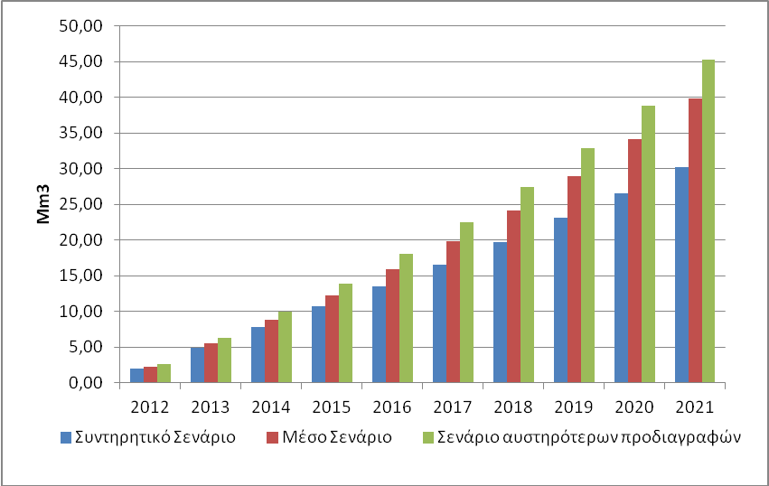
Building Level Measures (5)
Expected Results
Three alternative scenarios were considered:
Average Household size: 3 people
2012 new buildings: 40.000
2021: new buildings: 50.000 to 70.000
Watersavings per household> 30%
Watersaving targets: 54 – 60 – 68 m3
Differential Cost per household: €100

Slide 15
Building Level Measures (6)
Proposal B:
Rain water harvesting for new buildings in priority areas
PD 14.05.2002 (OG 402/D/2002)
Fifty Aegean islands are characterized as priority areas:
Water deficits
Intense seasonal population
Minimum storage capacity 5% of the yearly runoff
Areas and Capacity for public consultation

Slide 16
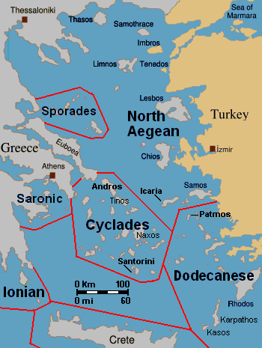
Building Level Measures (7)
Public consultation issue:
Fifty Aegean islands
or areas of islands
were defined as
priority areas
These islands already have problems with meeting present water demand, water prices are in most cases elevated (as compared to continental areas) and had a tradition in rainwater harvesting
Using the same criteria, should additional areas be included or should an area be excluded?

Slide 17
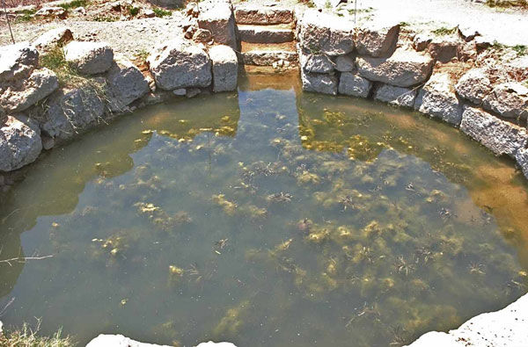
Building Level Measures (8)
Public consultation issue:
Rainwater storage should represent at least 5% of the total yearly runoff
Estimated storage:
10-20m3
Estimated runoff
area: 500-1000m2
Is the minimum storage capacity feasible?

Slide 18
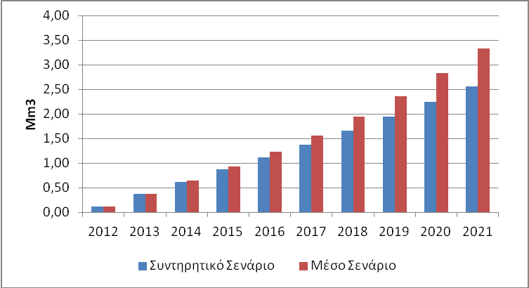
Building Level Measures (9)
Expected Results
Two implementation scenarios were examined:
Average household size: 3 people
2012 new buildings: 5.000
2021 new buildings: 6.500 to 10.500
Average watersaving per household > 20%
Differential cost per household~ € 500 - 1000

Slide 19
Product Level Measures(1)
Examined alternatives:
Voluntary labeling for WuPs
+
Results through
awareness
-
Actual savings
Uncertain
Mandatory labeling for WuPs
+
All Products are
rated
-
Actual savings not easily predictable
Minimum water performance requirements for WuPs
+
Direct savings results
Higher compliance cost
-

Slide 20
Product Level Measures (2)
Proposal:
Introducing a National Water Saving Label
The label can be voluntary at the beginning and mandatory at a later stage
The label can gradually cover:
Toilet flushes
Shower heads
Taps
Other WuPs
Labeling could use as a basis another national labeling schemes in order to minimize burden for producers
Labeling character, equipment covered and values for public consultation

Slide 21
Product Level Measures (3)
Public consultation issue:
Labeling can be mandatory or voluntary
Almost all of the existing water labeling schemes are voluntary
The EU energy labeling scheme is mandatory for some equipment
Labeling should not disproportionally increase product cost
Initialy Labeling can be voluntary and then mandatory for priority WuPs and voluntary for other features
Should Water Labeling be mandatory or voluntary, and do you agree with the defined priority WuPs?

Slide 22
Product Level Measures (4)
Public consultation issue:
Labeling provisions should minimize bureaucratic burden
Adopting or agreeing to a common labeling scheme with another EU country could be a way forward
Ratings similar to ANQIP’s for Toilet Flushes, Taps and Shower heads are proposed
Part of the exiting national market should be able to comply with AAA rating
Do you agree with the proposed ratings ?

Slide 23
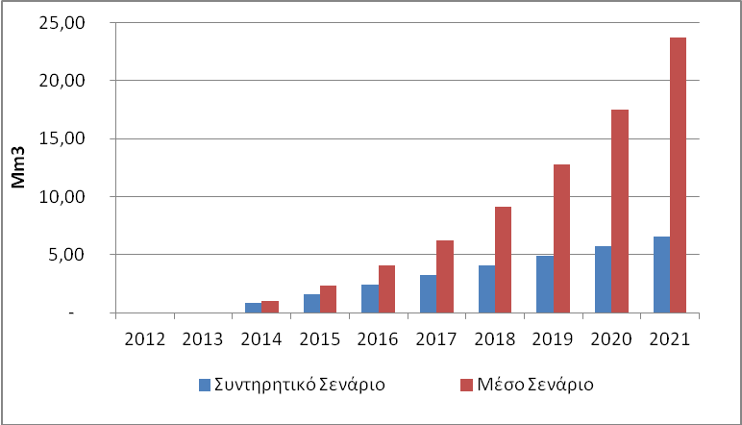
Product Level Measures (5)
Expected Results
Two implementation scenarios were examined:
5% of the market influenced by the Label
13.000 toilet flushers
150.000 taps
25.000 shower heads
5-30% of the market influenced by the Label
40.000 toilet flushers
450.000 taps
150.000 shower heads

Slide 24
Financial Incentives(1)
Examined alternatives:
Funding basic equipment replacement in old buildings (before year 2000) in priority areas, through water supply companies (type A, incentive)
Funding part of the cost of a rain harvesting system in existing buildings (before 2002) in priority areas, through water supply companies (type B, incentive)
+
Contributing to awareness
Administrative burden
-
Reluctance of water supply companies
Rebate programs through sail points (type A, incentive)
+
Contributing to awareness
-
Market agreement

Slide 25
Financial Incentives(5)
Public consultation issue:
The priority areas are defined as follows:
Priority areas in the Aegean island (eligible for type A and B incentives)
Cities with a population over 10.000 located within a WD with a hydrologic water deficit (eligible for type A incentives)
The incentive will represent 30% of the cost and will not exceed €100 for type A incentives and €500 for type B incentives
Should more areas or types of incentives be added ?

Slide 26
Financial Incentives (6)
Public consultation issue:
The intermediate body (ies), responsible for program implementation should be:
Water Supply Companies for type A and B incentives
WuP Sail Points for type A incentives and Water Supply Companies for type B incentives
A central Agency, formed for this purpose
The intermediate body must have the capacity to manage applications and control eligibility
What type of intermediate body would minimize administrative burden and maximize eligibility?

Slide 27
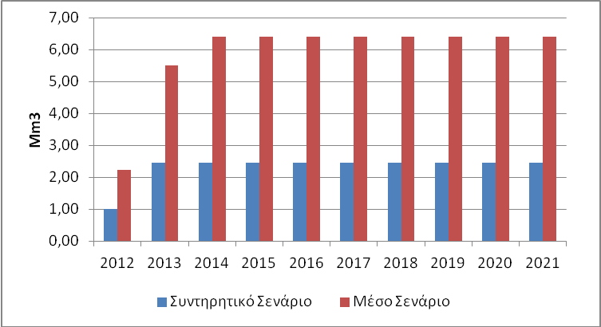
Financial Incentives(7)
Expected Results:
Two scenarios were evaluated
Average household size: 3 people
Households included in the program: 40.000- 80.000
Water saving per household: 20 – 50 %
Incentive cost: M€10- M€20

Slide 28
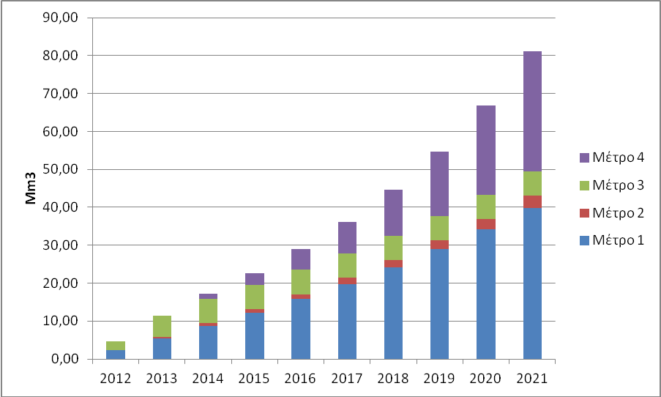
Conclusions(1)
Yearly water savings: 2012-2021
Measure1
Measure2
Measure3
Measure4

Slide 29
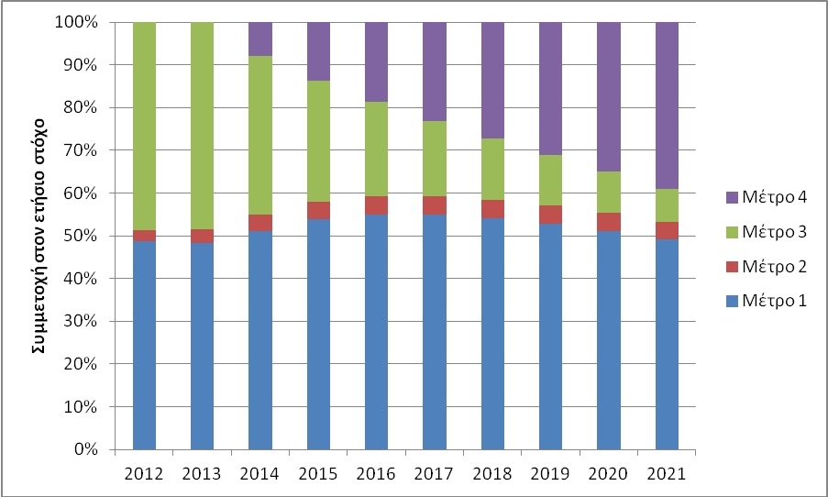
Conclusions(2)
Contribution of measures to yearly water savings
Measure1
Measure2
Measure3
Measure4

Slide 30
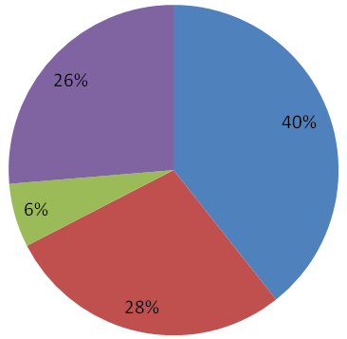
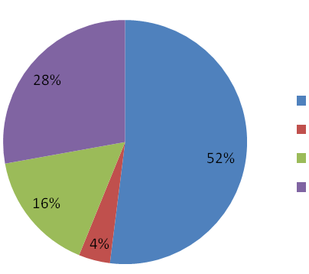
Conclusions(3)
Measure1
Measure2
Measure3
Measure4
% of cost
% of watersaving

Slide 31
Conclusions(4)
2012-2021: Total Results
Strategic Yearly Water Saving Target 80 Μm³ or 10%
50% of Greek households could be influenced
10-50% watersavings per influenced household
Implementation cost approx 150Μ€
Implementation benefit approx 450Μ€

Slide 32
Thank You for your Attention!

